Slide 1

HACK FOR INFINITY 2K26
NeuroRead
Making the Web Accessible for
ADHD & Dyslexic Minds
Problem Statement
Team
PS 01: NeuroInclusive Tech
Infinity 2K26

Slide 2
OVERVIEW
What We'll Cover Today
01
The Challenge
05
Our Solution
Understanding ADHD & Dyslexia
Introducing NeuroRead
02
The Reality
06
Features & Innovation
Statistics & Impact
Eight Powerful Tools
03
Proof of Potential
07
Technology Stack
Famous Neurodivergent Leaders
Architecture & Tools
04
Current Landscape
08
Impact & Use Cases
Existing Tools & Gaps
Real-World Applications

Slide 3
THE CHALLENGE
Understanding ADHD & Dyslexia
Dyslexia
ADHD
A neurological difference in how the brain processes language. Not a disease or reflection of intelligence—rather, a specific "wiring" that affects reading, writing, and spelling.
A neurodevelopmental condition affecting focus, impulse control, and energy levels. Divided into three types: Inattentive, Hyperactive-Impulsive, and Combined.
KEY INSIGHT
KEY INSIGHT
"Different ways of thinking, not deficits"
"Hyperfocus is a superpower"
Affects 10% of global population
Affects 5-7% of children, 2.5-4% of adults
Runs in families (genetic component)
Often co-occurs with dyslexia
Often accompanied by strengths in creativity
Associated with creativity & innovation
Core Message: These conditions represent different cognitive wiring, not deficits—often accompanied by unique strengths in creativity, problem-solving, and innovation.

Slide 4
THE DAILY STRUGGLE
Symptoms & Challenges
Dyslexia
ADHD
The Digital Gap
TEENS & ADULTS
INATTENTION
70%
• Very slow reading speed
• Difficulty staying on task
• Avoiding reading aloud
• "Time blindness" (losing track of time)
of websites have accessibility issues
• Difficulty summarizing stories
• Losing things frequently
• "Mental fatigue" after short reading
• Getting sidetracked easily
• Trouble with time management
20%
HYPERACTIVITY
PRIMARY SCHOOL
• Constant fidgeting
of population has learning differences
• Trouble matching letters to sounds
• Feeling "driven by a motor"
• Confusing similar letters (b/d, p/q)
• Struggling to sit still
• Inconsistent spelling in same paragraph
∞
IMPULSIVITY
VISUAL CROWDING
• Interrupting others
potential for inclusive design
Letters blur, "swim," or shift because the brain is overwhelmed by surrounding text
• Quick decisions without thinking
HYPERFOCUS
The Problem: Digital content is not designed for neurodivergent minds
A "superpower" where individuals become so engrossed they lose track of everything else

Slide 5
THE REALITY
By The Numbers
20%
10%
5-7%
70%
Global Population
Dyslexia
ADHD (Children)
Websites
Has a learning difference
Of the global population
Affects focus & energy
Have accessibility issues
The Scale of the Problem
The Digital Accessibility Gap
1.6 billion people worldwide have learning differences
98% of websites fail basic accessibility standards
780 million people with dyslexia globally
$13 trillion annual spending power of disabled community
366 million adults living with ADHD
71% of users with disabilities leave inaccessible sites
Co-occurrence: 30-40% of people with dyslexia also have ADHD
Legal risk: 4,000+ accessibility lawsuits filed annually

Slide 6
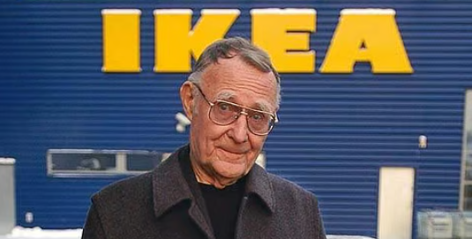

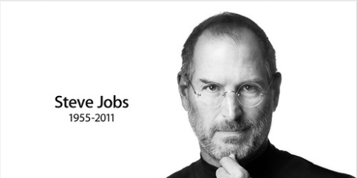
PROOF OF POTENTIAL
Dyslexic Leaders Who Changed the World
Ingvar Kamprad
Steven Spielberg
Steve Jobs
Founder of IKEA
Legendary Director
Apple Co-Founder
The Challenge: Struggled to remember long, numerical product codes due to dyslexia.
The Challenge: Wasn't diagnosed with dyslexia until age 60. Spent childhood feeling "slow" and was bullied in school.
The Challenge: Struggled with traditional schooling due to dyslexia. Found conventional education frustrating and limiting.
The Innovation: Instead of fighting his brain, he changed the system. Named furniture after Swedish islands, towns, and people (Billy, Klippan). He could visualize places much easier than numbers.
The Innovation: Because reading was hard, he retreated into visual storytelling. Spent time "thinking in pictures" and storyboarding. This visual-first brain made him a legendary filmmaker.
The Innovation: Led to an obsession with minimalism and intuition. Didn't want manuals; wanted devices so intuitive you didn't need to read to understand them.
This "flaw" created IKEA's iconic naming system known worldwide
He sees a movie in his head before ever reading the script
Created technology that "just works" without instructions
Key Insight: These leaders didn't succeed despite their dyslexia—they succeeded because of their unique cognitive wiring.

Slide 7
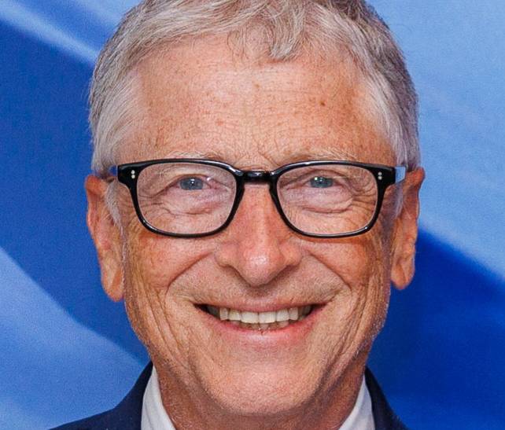

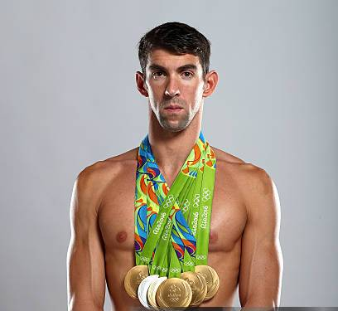

PROOF OF POTENTIAL
ADHD Leaders Who Changed the World
Bill Gates
Richard Branson
Michael Phelps
Justin Timberlake
Emma Watson
Microsoft
Virgin Group
Olympic Legend
Entertainer
Actor & Activist
Has both ADHD and Dyslexia. Spoke about struggles with traditional education.
Vocal neurodiversity advocate. Uses "restless" energy to run 400+ companies.
Used swimming to manage ADHD energy. Used "hyperfocus" to win 23 gold medals.
Manages both ADHD and OCD while maintaining massive music and acting career.
Diagnosed with ADHD as child. Used structure to succeed at Brown and Oxford.
"Out-of-the-box thinker"
"High energy innovator"
"Hyperfocus champion"
"Multi-talented performer"
"Structured success"
Common Threads
Credit ADHD for "out-of-the-box" thinking
These leaders prove that ADHD is not a limitation—it's a different way of thinking that can drive extraordinary achievement.
High energy channeled into productivity
Hyperfocus used as competitive advantage

Slide 8
CURRENT LANDSCAPE
Existing Tools & The Gap
Reading & Focus
AI & Text-to-Speech
Fonts & Writing
• Microsoft Immersive Reader
• Speechify
• OpenDyslexic Font
• Beeline Reader
• DyslexiaBuddy (2026)
• Dyslexie Font
• Helperbird
• NaturalReader
• Ghotit Real Writer
• ClaroRead / Visor
• Voice Dream Reader
• Grammarly
• Snap&Read
• Ello Reading Coach
• Co:Writer
ADHD Focus Tools
The Gap We're Filling
Goblin.tools: AI breaks big tasks into tiny steps
Fragmented solutions: No single tool combines all features
Motion: AI Executive Assistant for scheduling
Multiple subscriptions: Users need 5+ different tools
Brain.fm: AI-generated focus music
No eye tracking: Missing hands-free reading innovation
MindMate GPT: Distraction manager
Limited integration: Don't work across all websites

Slide 9

OUR SOLUTION
Introducing NeuroRead
The all-in-one Chrome Extension that transforms how people with ADHD and Dyslexia experience digital content.
Keyboard Navigable
Full keyboard shortcuts support
Core Value Proposition
Alt + B: Bionic Reading
Alt + F: Focus Mode
We combine the best of existing tools with innovative new features in one seamless extension.
Screen Reader Compatible
Works with assistive technologies
Works on ANY website
No account required
Local Processing
Your data never leaves your device
Privacy-focused
Fully accessible UI

Slide 10
FEATURES & INNOVATION
Eight Powerful Tools
Bionic Reading
Focus Mode
Eye Tracking
Auto Scroll
Bold the first half of words to create visual anchor points. Scientifically proven to improve reading speed and comprehension.
Strip away distractions like ads, sidebars, and clutter. Just the content you want in a clean, beautiful interface.
Use your webcam to track gaze and automatically scroll as you read. Hands-free reading at its finest.
Set your reading speed and let the page scroll automatically. Perfect for hands-free reading sessions.
FOR DYSLEXIA
FOR ADHD
INNOVATION
FOR ADHD
Text to Speech
Word Highlight
AI Summarizer
Accessibility Themes
Listen to content while following along with word highlighting. Supports multiple voices and speeds.
Keep your place with a moving highlight that follows your reading. Never lose your spot again.
Get key points from any article in seconds with our AI-powered summarization backend.
5 themes: Default, Sepia, Dark, High Contrast, and Dyslexia-Friendly with OpenDyslexic font.
FOR DYSLEXIA
FOR ADHD
FOR EVERYONE
FOR EVERYONE
All features work together seamlessly — toggle any combination to create your perfect reading environment

Slide 11
TECHNOLOGY
Innovation & Technology Stack
Innovation Highlights
Technology Stack
Eye Tracking
Chrome Extension API
Webcam-based gaze detection for hands-free reading. Uses computer vision to track eye movement and automatically scroll content.
Manifest V3 for modern browser integration
JavaScript (ES6+)
Core functionality with modern standards
Adaptive Scroll
Speed adjusts based on reading patterns. AI learns your pace and adapts in real-time for optimal comfort.
CSS3
Styling and animations
AI Summarization
Node.js + Express
Intelligent content condensation using OpenAI API. Extracts key points while preserving meaning and context.
Backend API for AI services
React
Dashboard interface
Web Speech API
OpenAI API
WebGazer.js

Slide 12
IMPACT
Impact & Use Cases
For ADHD Readers
For Dyslexic Readers
For Everyone
Focus Mode
Bionic Reading
AI Summarizer
Removes distractions that break concentration—ads, sidebars, popups
Creates visual anchors preventing line skipping and improving speed
Quickly extracts key information from any article
Word Highlight
Dyslexia Theme
Focus Mode
Keeps your place when your mind wanders. Never lose your spot again.
OpenDyslexic font with optimized spacing and contrast
Creates clean reading environment free from clutter
Auto Scroll
Text to Speech
Multiple Themes
Maintains reading flow without manual scrolling effort
Audio support for difficult words with visual highlighting
Reduces eye strain with customizable color schemes
"Finally, I can read without getting distracted every 30 seconds"
"The bionic reading feature is a game-changer for me"
"I use it even though I don't have dyslexia—it's just better reading"

Slide 13
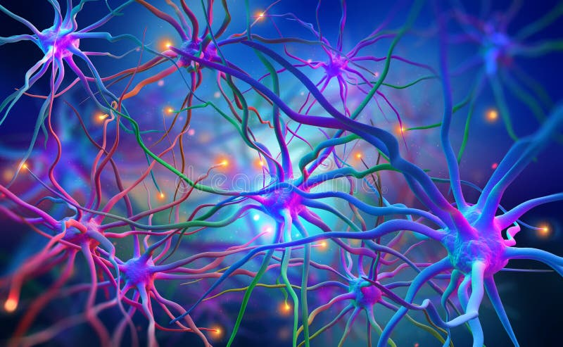
NEUROREAD
Making the Web Accessible
for Everyone
20%
70%
∞
of the population has a
learning difference
of websites have
accessibility issues
potential for
inclusive design
Made with love for the neurodivergent community
Hack for Infinity 2K26 | Problem Statement 01: NeuroInclusive Tech

